Slide 1
Chapter 17: Designing an Architecture
Pingjian Zhang
School of Software Engineering, SCUT
2018

Slide 2
Chapter Outline
Design Strategy
The Attribute-Driven Design Method
The Steps of ADD
Summary

Slide 3
Design Strategy
Decomposition
Designing to Architecturally Significant Requirements
Generate and Test

Slide 4
Decomposition
Architecture determines quality attributes
Important quality attributes are characteristics of the whole system.
Design therefore begins with the whole system
The whole system is decomposed into parts
Each part may inherit all or part of the quality attribute requirements from the whole

Slide 5
Design Doesn’t Mean Green Field
If you are given components to be used in the final design, then the decomposition must accommodate those components.
New component
New
Component
Given components
New
Component
New
Component

Slide 6
Designing to Architecturally Significant Requirements
Remember architecturally significant requirements (ASRs)?
These are the requirements that you must satisfy with the design
There are a small number of these
They are the most important (by definition)

Slide 7
How Many ASRs Simultaneously?
If you are inexperienced in design then design for the ASRs one at a time beginning with the most important.
As you gain experience, you will be able to design for multiple ASRs simultaneously.

Slide 8
What About Other Quality Requirements?
If your design does not satisfy a particular non ASR quality requirement then either
Adjust your design to satisfy it
Weaken it to be satisfied
Make it become one of the ASRs
Declare it non-satisfiable
Notes:
支持所有硬件平台

Slide 9
Generate and Test
View the current design as a hypothesis.
Ask whether the current design satisfies the requirements (test)
If not, then generate a new hypothesis
Generate Initial Hypothesis
Test hypothesis
Generate Next Hypothesis

Slide 10
Raises the Following Questions
Where does initial hypothesis come from?
How do I test a hypothesis?
When am I done?
How do I generate the next hypothesis?

Slide 11
Where Does the Initial Hypothesis Come From?
Desirable sources
Existing systems
Frameworks
Less desirable sources
Patterns and tactics
Domain decomposition
Design checklists
Why “less desirable”?
The less desirable ones do not cover all of the requirements. They typically omit many of the quality attribute requirements.

Slide 12
How Do I Test a Hypothesis?
Use the analysis techniques already covered
Design strategies from quality attribute discussion.
Architecturally significant requirements
What is the output of the tests?
List of requirements not met by current design.

Slide 13
How Do I Generate the Next Hypothesis?
Add missing responsibilities.
Use tactics to adjust quality attribute behavior of hypothesis.
The choice of tactics will depend on which quality attribute requirements are not met.
Be mindful of the side effects of a tactic.

Slide 14
When Am I Done?
When…
All ASRs are satisfied and/or…
You run out of budget for design activity,In this case
use the best hypothesis so far
Begin implementation
Continue with the design effort although it will now be constrained by implementation choices.

Slide 15
The Attribute-Driven Design Method
Packaging of many of the techniques already discussed.
An iterative method. At each iteration you
Choose a part of the system to design.
Marshal all the architecturally significant requirements for that part.
Generate and test a design for that part.
ADD does not result in a complete design
Set of containers with responsibilities
Interactions and information flow among containers
Does not produce an API or signature for containers.

Slide 16
ADD Inputs and Outputs
Requirements
Functional
Quality
Constraints
ADD Process
Containers
Responsibilities
Interactions
Information flow

Slide 17
The Steps of ADD
Choose an element of the system to design.
Identify the ASRs for the chosen element.
Generate a design solution for the chosen element.
Inventory remaining requirements and select the input for the next iteration.
Repeat steps 1–4 until all the ASRs have been satisfied.

Slide 18
Step 1: Choose an Element of the System to Design
For green field designs, the element chosen is usually the whole system.
For legacy designs, the element is the portion to be added.
After the first iteration:
Whole System
Element 1
Element N

Slide 19
Which Element Comes Next?
Two basic refinement strategies:
Breadth first
Depth first
Which one to choose?
It depends ☺
If using new technology => depth first: explore the implications of using that technology.
If a team needs work => depth first: generate requirements for that team.
Otherwise => breadth first.

Slide 20
Step 2: Identify the ASRs for the Chosen Element
If the chosen element is the whole system, then use a utility tree.
If the chosen element is further down the decomposition tree, then generate a utility tree from the requirements for that element.

Slide 21
Step 3: Generate a Design Solution for the Chosen Element
Apply generate and test to the chosen element with its ASRs

Slide 22
Step 4: Select the Input for the Next Iteration
For each functional requirement
Ensure that requirement has been satisfied.
If not, then add responsibilities to satisfy the requirement.
Add them to container with similar requirements (coherence)
If no such container may need to create new
If container has too many requirements for a team, split it into two portions. Try to achieve loose coupling when splitting.

Slide 23
Quality Attribute Requirements
If the quality attribute requirement has been satisfied, it does not need to be further considered.
If the quality attribute requirement has not been satisfied then either
Delegate it to one of the child elements
Split it among the child elements
If the quality attribute cannot be satisfied, see if it can be weakened. If it cannot be satisfied or weakened then it cannot be met.

Slide 24
Constraints
Constraints are treated as quality attribute requirements that have been treated.
Satisfied
Delegated
Split
Unsatisfiable

Slide 25
Repeat Steps 1–4 Until All ASRs are Satisfied
At end of step 3, each child element will have associated with it a set of:
functional requirements,
quality attribute requirements, and
constraints.
This sets up the child element for the next iteration of the method.

Slide 26
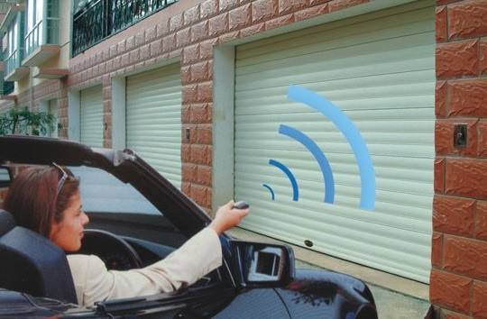

Slide 27
Garage Door Opener Example 设计一个车库门开关器产品线构架
Design a product line architecture for a garage door opener with a larger home information system
Input to ADD: a set of requirements
Functional requirements as use cases
Constraints
Quality requirements expressed as system-specific quality scenarios
Notes:
The opener is responsible for raising and lowering the door via a switch, remote control, or the home information system. 安防：自动短信彩信报警

Slide 28
Scenarios for Garage Door System
Device and controls are different for the various products in the product line
The processor will differ
If an obstacle is perceived during descent it must stop within 0.1 seconds
The door opener system needs to be accessible from the home information system for diagnosis and control

Slide 29
1 Choose the Module to Decompose
System → subsystem → submodule
For the garage door opener, is the system
One constraint at this level is that the opener must interoperate with the home information system.

Slide 30
2 Identify the Architectural Drivers
In the Garage System, the 4 scenarios were architectural drivers

Slide 31
3 Generate a Design
The pattern needs to satisfy the architectural drivers and is built by “composing” the tactics selected to satisfy the drivers
Two factors involved in selecting tactics:
Architectural drivers themselves of course
Side effects of the pattern implementing the tactic on other requirements
Notes:
For example, a classic tactic to achieve modifiability is the use of an interpreter. Adding an interpreted specification language to a system simplifies the creation of new functions or the modification of existing ones. An interpreter is an excellent technique for achieving modifiability at runtime, but it has a strong negative influence on performance. The decision to use one depends on the relative importance of modifiability versus performance.

Slide 32
3 Generate a Design
The performance and modifiability are the most critical quality attributes.
For modifiability, choose “semantic coherence” and “information hiding” as our tactics and combine them to define virtual machines for the affected areas.
For performance, choose "increase computational efficiency" from "resource demand" and scheduling policy from "resource arbitration" .

Slide 33
3 Generate a Design
Semantic coherence and information hiding. Separate responsibilities dealing with
User interface
Communication
Sensors
Call each of these virtual machines and expect variation within product line
Increase computational efficiency. The performance-critical computations should be made as efficient as possible.
Schedule wisely. The performance-critical computations should be scheduled to ensure the achievement of the timing deadline.
Notes:
高效准确的检测算法

Slide 34
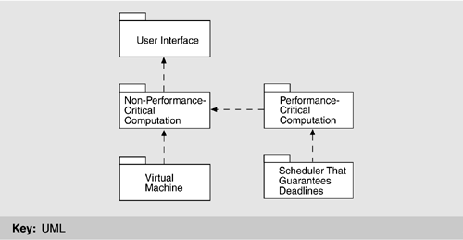
Architectural Pattern that Utilizes Tactics

Slide 35
3 Generate a Design
Raising/lower door (normal mode) and diagnosis - non-critical
Managing obstacle detection - critical
Virtual machine sensor/actuator
Virtual machine communication

Slide 36
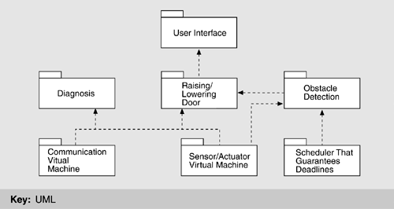
3 Generate a Design
Notes:
the non-performance-critical module: instantiated as diagnosis and raising/lowering door modules
two instances of the virtual machine
performance-critical module

Slide 37
Allocate Functionality Using Multiple Views
Applying use cases that pertain to the parent module helps the architect gain a more detailed understanding of the distribution of functionality. This also may lead to adding or removing child modules to fulfill all the functionality required.
Assigning responsibilities to the children in a decomposition also leads to the discovery of necessary information exchange. (producer/consumer, publish-subscribe…)
Notes:
every use case of the parent module must be representable by a sequence of responsibilities within the child modules

Slide 38
Use Cases Illustrating Concurrency
Two users doing similar things at the same time. This helps in recognizing resource contention or data integrity problems. In our garage door example, one user may be closing the door remotely while another is opening the door from a switch.
One user performing multiple activities. This helps to uncover data exchange and activity control problems. In our example, a user may be performing diagnostics while simultaneously opening the door.

Slide 39
Use Cases Illustrating Concurrency
Starting up the system, this helps in deciding on an initialization strategy. In our example, does the startup of the garage door opener system depend on the availability of the home information system? Is the garage door opener system always working, waiting for a signal, or is it started and stopped with every door opening and closing?
Shutting down the system. This helps to uncover issues of cleaning up, such as achieving and saving a consistent system state.

Slide 40
Verify and Refine Use Cases and Quality Scenarios
We now have a “proposal” for the decomposition of the module.
The next step is to analyze it and see how well it fits. This involves
Verifying the decomposition by “running” the parent’s use cases
Preparing children for their own decomposition by inheriting use cases/constraints from the parent.
We will examine this by looking at
Functional requirements
Constraints
Quality Scenarios
Notes:
Another way of defining use cases is to split and refine the parent use cases. For example, a use case that initializes the whole system is broken into the initializations of subsystems.

Slide 41
Functional Requirements
Using Functional requirements to verify and refine
Decomposing functional requirements assigns responsibilities to child modules
We can use these responsibilities to generate use cases for the child module
E.g. Garage door system responsibilities
Open/close the door at the switch, remote or house
To stop the closing when an obstacle is perceived
To interact with the home information system
These responsibilities can be assigned to the child modules

Slide 42
Functional Groups
User Interface:
handle user requests,
translate for raising/lowering module
display responses
Raising/Lowering Door Module
Control actuators to raise/lower door
Stop when completed opening or closing
Obstacle detection:
Recognize when object is detected
Stop or reverse the closing of the door
Communication Virtual Machine
manage communication with House Information System (HIS)
Sensor/Actuator virtual machine
manage interactions with sensors/actuators
Scheduler: guarantee that deadlines are met when obstacle is detected
Diagnosis: manage diagnosis interaction with HIS

Slide 43
Quality Scenarios Assigned in the Example
The devices and controls for opening and closing are different in the products of the product line. Scenario delegated to user-interface module.
The processor used in different products will differ. Delegated to all modules - “don’t use processor specific code”
If an obstacle is detected closing must stop within .1 sec. Delegated to scheduler and obstacle-detection modules.
Garage door system must interact with the HIS. Delegated to communication and diagnosis modules.

Slide 44
Summary
Designing the architecture is a matter of
Determining the ASRs
Performing generate and test one an element to decompose it to satisfy the ASRs
Iterating until requirements are satisfied.

